Slide 1
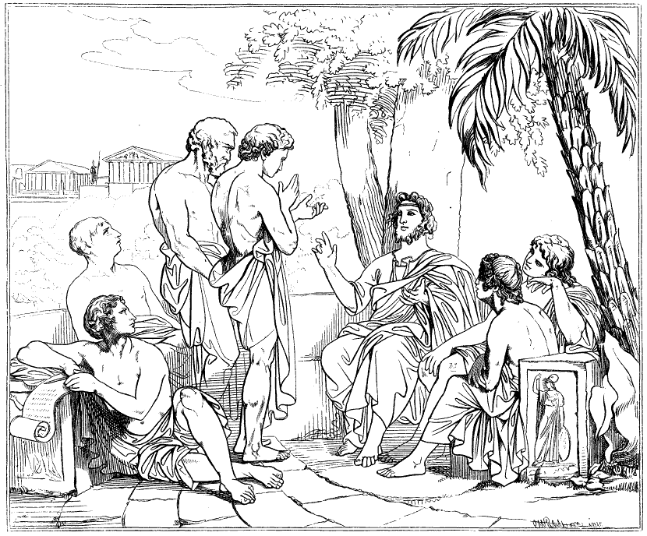
Plato’s Theory of Forms

Slide 2
Plato’s Theory of Forms
The idea of the Forms is illustrated in the Allegory of the Cave.
Plato believed true reality existed beyond normal perceptions of the world.
What we perceive around us is a shadow of this truth.

Slide 3
What is real?
How do you know?

Slide 4
Recognising Forms
We can recognise Forms because we are born with a dim recollection of them from our prior existence in the world of the Forms.
There is an inner part of us (the soul) that does not change. It is eternal and, before it became tied down by a body, it was connected with the real world of Forms.

Slide 5
Plato’s Theory of Forms
According to Plato the world we live in is a poor imitation of the real world.
Our world is constantly changing and we rely on our senses to understand what is going on.
You are not the same person you were 3 years/hours/seconds ago, cells are forever changing and ideas flit through our minds.
Plato was therefore sure that the real world is outside the one we live in.
This real world is unchanging and eternal. It is the world of ideas not senses, where there are perfect forms of the things we know on earth.

Slide 6
The Material World | The World of the Forms
Transitory- moves in time and space | Outside of time and space
Relative | Real and absolute
Changing | Unchanging
Impermanent | Permanent
Superficial | What matters most
Contradictory- are subject to opinion | NO-contradiction- they are NOT subject to opinion
Sensory | Beyond the senses
Can be measured | Immeasurable
Imperfect | Perfect

Slide 7
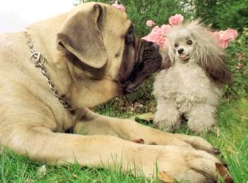
Activity
Draw a dog

Slide 8
It is impossible to get a clear definition and rule out other animals at the same time.
A 3 year old would have no problem distinguishing a dog from another animal.
The child is identifying the form whilst we are getting bogged down with the details.
The Form is not a shape, it is the essence of an object.
A dog and all dogs have a degree of ‘dogginess’ due to participating in the form.

Slide 9
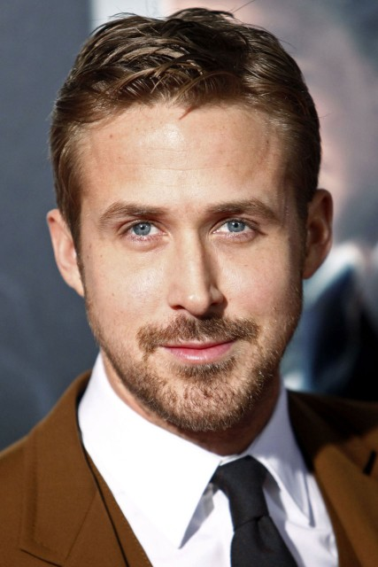
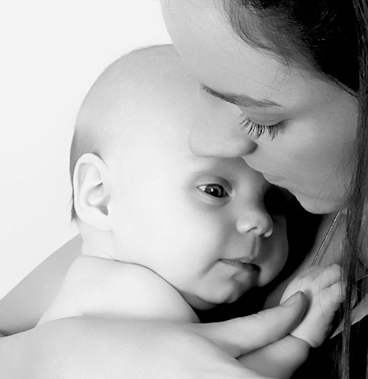
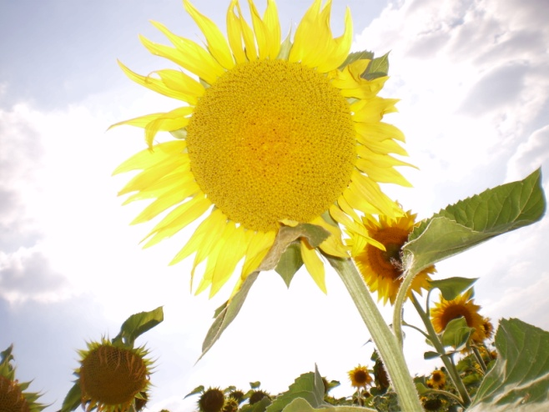

Slide 10
The beautiful person participates or shares in beauty with all other beautiful things, but beauty itself is beyond our normal perception.
“Her/his eyes are too close together” – we can recognise that she/he falls short of beauty and thus understand the concept of beauty due to our prior knowledge, yet we have not ever experienced a perfect example of beauty.

Slide 11
However…
The world of the Forms is the philosopher’s world.
The ordinary person struggles to see past the illusion of this world because they are ruled by their senses.
Only the person who investigates and questions learns the truth behind the illusion.
Only the philosopher is capable of seeing into the world of the Forms because he can make judgements as he thinks independently of his senses.

Slide 12
Summing up...
The Material World (our world)
Here the material objects exist, subject to change and decay. They take their identity from the way that they conform to their corresponding idea in the world of the Forms.
The World of the Forms
Here the patterns for the objects and concepts for the material world exist in a state of unchanging perfection.
The material world is a shadow of the ‘real’ world of the Forms.
It is the job of the philosopher to break free from the shackles of the material world and find the world of the Forms.

Slide 13
Summing up continued…
A Form is what a thing is
Forms for Plato are unchanging and eternal
Objects in this world imitate a Form which exists in the real world e.g. A beautiful person is an image of beauty
We are born with a recollection of what Forms are
Forms are only accessible to philosophers

